Slide 1
Bug Survey
Yubin Xia
Some slides adjusted from Frans Kaashoek (MIT), Shan Lu (U. Wisc) and Ding Yuan (U. Toronto)

Slide 2
Outline
Recap
Understanding Concurrency bugs
OS Bugs
Data race detection

Slide 3
Recap: How to do with reader – write locks?
GetEvents(date) {
readerStart(maRWLock);
List events = EventMap.find(date).copy();
readerFinish(mapRWLock);
return events;
}
AddEvent(data, newEvent) {
writerStart(maRWLock);
EventMap.find(date) += newEvent;
writerFinish(mapRWLock);
}

Slide 4
Recap: Basic Implementation
readerStart() {
lock(lockRW);
while(numWriters > 0){
wait(lockRW,condRW);
};
numReaders++;
unlock(lockRW);
}
readerFinish() {
lock(lockRW);
numReaders--;
broadcast(lockRW,condRW);
unlock(lockRW);
}

Slide 5
Recap: Basic Implementation
writerStart() {
lock(lockRW);
while(numReaders > 0||
numWriters >0){
wait(lockRW,condRW);
};
numWriters++;
unlock(lockRW);
}
writerFinish() {
lock(lockRW);
numWriters--;
broadcast(lockRW,condRW);
unlock(lockRW);
}

Slide 6
Recap: Better Implementation
readerStart() {
lock(lockRW);
while(numWriters > 0){
wait(lockRW,condRW);
};
numReaders++;
unlock(lockRW);
}
readerFinish() {
lock(lockRW);
numReaders--.
if(numReaders == 0){
signal(lockRW,condWR);
};
unlock(lockRW);
}

Slide 7
Concurrency bug characteristics

Slide 8
Survey
105 real-world concurrency bugs from 4 large open source programs
Study from 4 dimensions
Bug patterns
Manifestation condition
Diagnosing strategy
Fixing methods
Implications for:
Bug detection
Software testing
PL design

Slide 9
Outline
Methodology
Findings and implications
Bug pattern
Bug manifestation
Bug fixing
Conclusions

Slide 10
Application sources
 | MySQL | Apache | Mozilla | OpenOffice
Software Type | Server | Server | Client | GUI
Language | C++/C | Mainly C | C++ | C++
LOC (M line) | 2 | 0.3 | 4 | 6
Bug DB history | 6 years | 7 years | 10 years | 8 years
Different types of
real world applications

Slide 11
Bug sources
 | MySQL | Apache | Mozilla | OpenOffice | Total
Non-deadlock | 14 | 13 | 41 | 6 | 74
Deadlock | 9 | 4 | 16 | 2 | 31
Limitations
No scientific computing applications
No JAVA programs
Never-enough bug samples

Slide 12
Non-Deadlock Bug Pattern
Classified based on root causes
Categories:
Atomicity violation
Desired atomicity of certain code region is violated
Order violation
The desired order between two (sets of) accesses is flipped
Others

Slide 13
Atomicity violation
The desired atomicity of certain code region is violated
Thread 1
Thread 2
X

Slide 14
Example of atomicity violation
Thread 1
Thread 2
if (thd->proc_info) {
…
fputs(thd->proc_info, …)
…
}
thd->proc_info = NULL;
MySQL ha_innodb.hpp

Slide 15
Example of atomicity violation
Thread 1
Thread 2
should be atomically executed
if (thd->proc_info) {
…
fputs(thd->proc_info, …)
…
}
thd->proc_info = NULL;
MySQL ha_innodb.hpp

Slide 16
Example of atomicity violation
Thread 1
Thread 2
if (thd->proc_info) {
…
fputs(thd->proc_info, …)
…
}
thd->proc_info = NULL;
MySQL ha_innodb.hpp

Slide 17
Order violation
The desired order between two (sets of) accesses is flipped
Thread 1
Thread 2
X

Slide 18
Example of order violation
Thread 1
Thread 2
void MgmtSrvr::status(…)
{
*myid =
node.m_state.dynamicid;
…
}
void NodeState::setDynamicId(int id)
{
// initialized here
dynamicid = id;
…
}
MySQL NodeState.hpp

Slide 19
Example of order violation
Thread 1
Thread 2
void NodeState::setDynamicId(int id)
{
// initialized here
dynamicid = id;
…
}
void MgmtSrvr::status(…)
{
*myid =
node.m_state.dynamicid;
…
}
correct order
MySQL NodeState.hpp

Slide 20
Example of order violation
Thread 1
Thread 2
void MgmtSrvr::status(…)
{
*myid =
node.m_state.dynamicid;
…
}
void NodeState::setDynamicId(int id)
{
// initialized here
dynamicid = id;
…
}
buggy order
MySQL NodeState.hpp

Slide 21

Non-deadlock bug pattern
51(69%)
Implications
We should focus on atomicity violation and order violation
24(32%)
2(3%)

Slide 22
Non-deadlock bug pattern
51(65%)
Implications
We should focus on atomicity violation and order violation
Bug detection tools for order violation bugs are desired
24(32%)
2(3%)

Slide 23
How to trigger a bug
Bug manifestation condition
A specific execution order among a smallest set of memory accesses
The bug is guaranteed to manifest, as long as the condition is satisfied
How many threads are involved?
How many variables are involved?
How many accesses are involved?

Slide 24
Single Variable vs. Multiple Variable
Findings
49(66%)
25(34%)

Slide 25
Single Variable vs. Multiple Variable
Single variables are more common
The widely-used simplification is reasonable
Multi-variable concurrency bugs are non-negligible
Techniques to detect multi-variable concurrency bugs are needed

Slide 26
Multi-Variable Concurrency Bug Example
Thread 1
Thread 2
js_FlushPropertyCache ( … ) {
memset ( cache→table, 0, SIZE);
…
cache→empty = TRUE;
}
js_PropertyCacheFill ( … ) {
cache→table[indx] = obj;
…
cache→empty = FALSE;
}
Control the order among accesses to any one variable
can not guarantee the bug manifestation

Slide 27
Non-deadlock bugs Number of Accesses
7(9%)

Slide 28
Deadlock bugs Number of Accesses
1 (3%)

Slide 29
Implications
Only a few percentage of bugs need more than 4 access to trigger
Concurrent program testing can focus on small groups of accesses
The testing target shrinks from exponential to polynomial

Slide 30
Number of Threads Involved
101 out of 105 (96%) bugs involve at most two threads
Most bugs can be reliably disclosed if we check all possible interleaving between each pair of threads
Few bugs cannot
Example: Intensive resource competition among many threads causes unexpected delay

Slide 31
How Were Non-Deadlock Bugs Fixed?
Adding/changing locks 20 (27%)
Condition check 19 (26%)
Data-structure change 19 (26%)
Code switch 10 (13%)
Other 6 (8%)
Implications
No silver bullet for fixing concurrency bugs.
Lock usage information is not enough to fix bugs.

Slide 32
How Were Deadlock Bugs Fixed?
Might introduce
non-dead locks
Give up resource acquisition 19 (61%)
Change resource acquisition order 7 (23%)
Split the resource to smaller ones 1 ( 3%)
Others 4 (13%)
We need to pay attention to the correctness of “fixed” deadlock bugs

Slide 33
Other findings
Impact of concurrency bugs
~ 70% leads to program crash or hang
Reproducing bugs are critical to diagnosis
Programmers lack diagnosis tools
Most are diagnosed via code review
Reproduce bugs are extremely hard and directly determines the diagnosing time
60% 1st-time patches contain concurrency bugs (old or new)

Slide 34
Summary
Bug detection needs to look at order-violation bugs and multi-variable concurrency bugs
Testing can target at more realistic interleaving coverage goals
Fixing concurrency bugs is not trivial and not easy to get right
Support from automated tools is needed

Slide 35
BUGS in Exception handlers

Slide 36
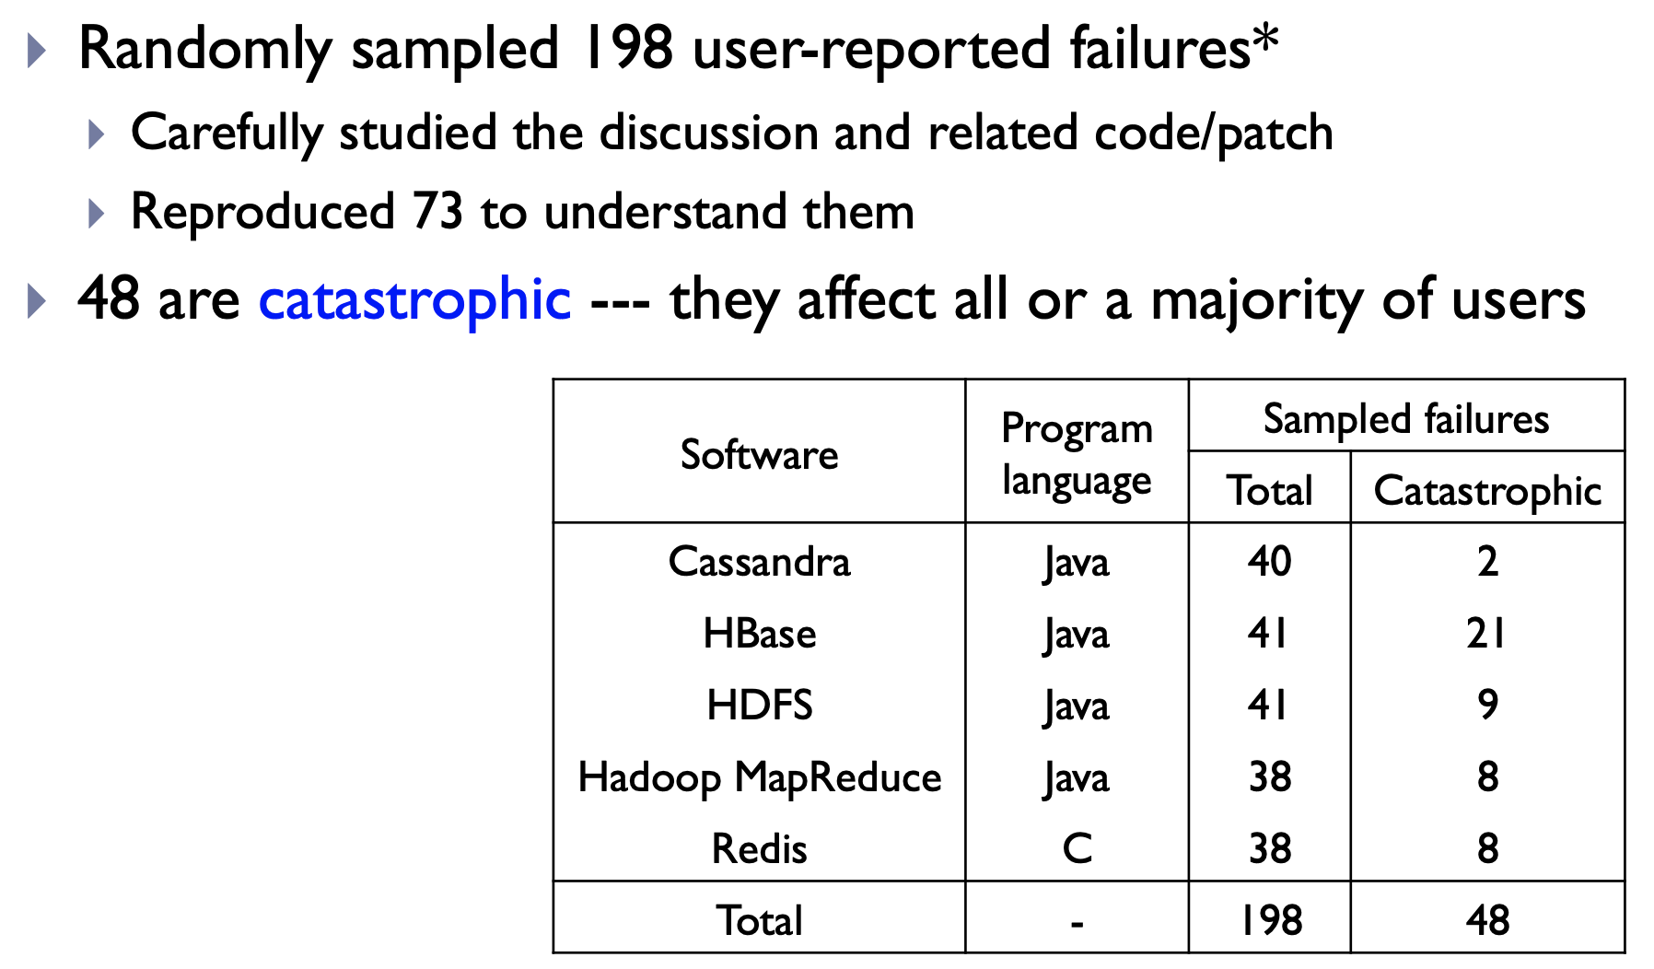
Study Methodology

Slide 37
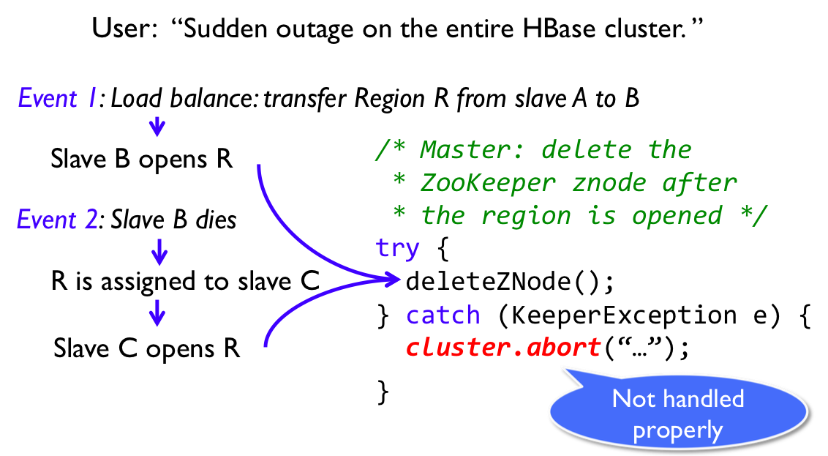
Multiple Events are Required

Slide 38
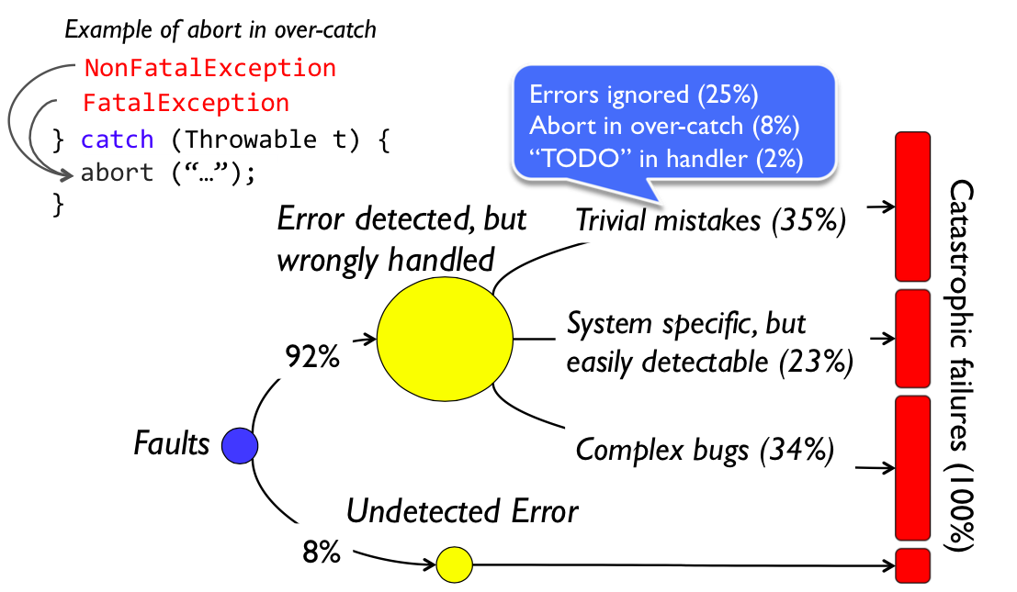
Breakdown of catastrophic failures

Slide 39
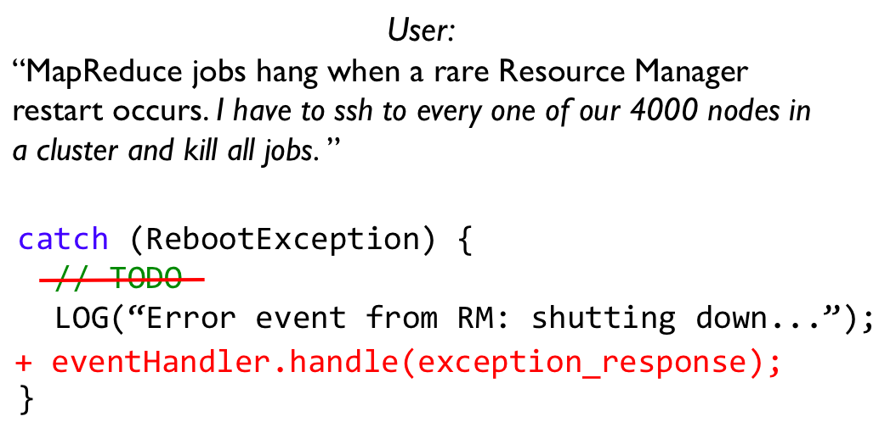
A failure caused by trivial mistake

Slide 40
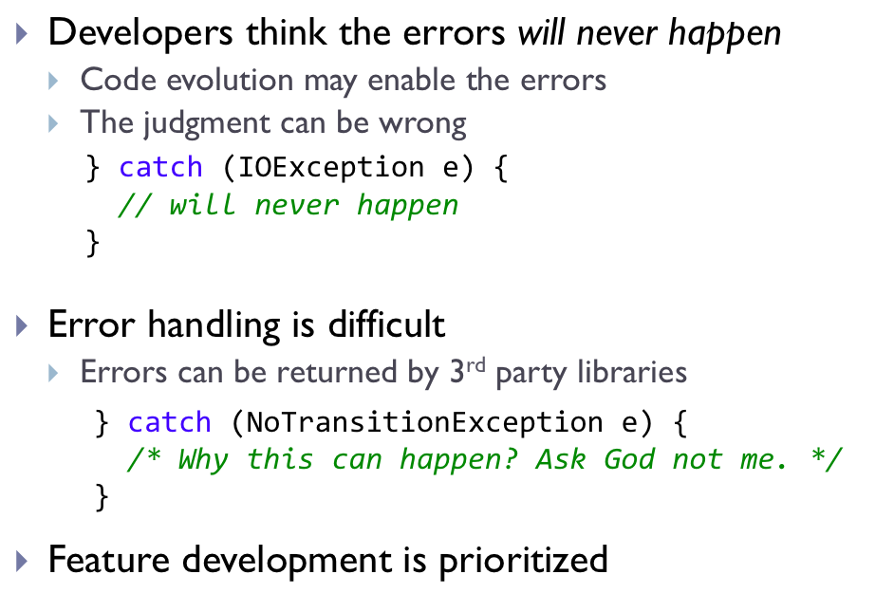
Why do developers ignore error handling?

Slide 41
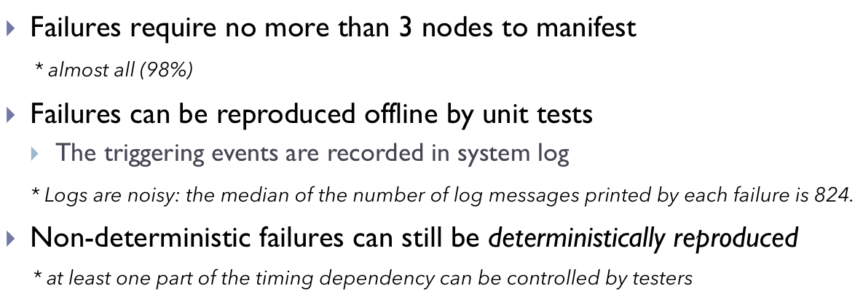
Other Findings

Slide 42
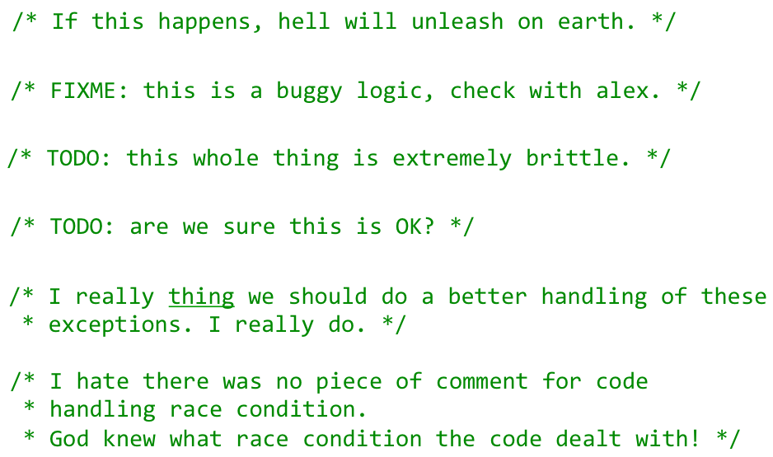
Unexpected fun: comments in error handlers

Slide 43
OS Bugs

Slide 44
Bugs Cost??
Patriot missile defense system
28 dead soldiers, 98 wounded
Therac-25 medical device
Several people dead, others wounded
General Electric XA/21
50 million people left without water, electricity.
Notes:
A software bug known as a race condition[vague]existed in General Electric Energy's Unix-based XA/21 energy management system. Once triggered, the bug stalled FirstEnergy's control room alarm system for over an hour. System operators were unaware of the malfunction. The failure deprived them of both audio and visual alerts for important changes in system state.

Slide 45
How to find bugs?
What is your belief set?
MUST set
MAY set
What is the implied sets?
Inconsistency means possible bugs!!

Slide 46
Trivial consistency: NULL pointers
*p implies a MUST belief:
p is not null
A check (p == NULL) implies two MUST beliefs:
POST: p is null on true path, not null on false path
PRE: p was unknown before check
/* 2.4.1: drivers/isdn/svmb1/capidrv.c */
if(!card)
printk(KERN_ERR, “capidrv-%d: …”, card->contrnr…)
/* drivers/net/wan/sdla_chdlc.c:3948 */ if (!card){ lock_adapter_irq(&card->wandev.lock,&smp_flags); card->tty=NULL;

Slide 47
Null pointer fun
Use-then-check
Contradiction/redundant checks
/* 2.4.7: drivers/char/mxser.c */
struct mxser_struct *info = tty->driver_data;
unsigned flags;
if(!tty || !info->xmit_buf)
return 0;
/* 2.4.7/drivers/video/tdfxfb.c */ fb_info.regbase_virt = ioremap_nocache(...); if(!fb_info.regbase_virt)
return -ENXIO; fb_info.bufbase_virt = ioremap_nocache(...); if(!fb_info.regbase_virt) { iounmap(fb_info.regbase_virt);

Slide 48
Internal Consistency: finding security holes
Applications are bad:
Rule: “do not dereference user pointer <p>”
One violation = security hole
Big Problem: which are the user pointers???
Sol’n: for-all pointers, cross-check two OS beliefs
“*p” implies safe kernel pointer
“copyin(p)/copyout(p)” implies dangerous user pointer
Error: pointer p has both beliefs.

Slide 49
Statistical: Deriving deallocation routines
Use-after free errors are horrible.
Problem: lots of undocumented sub-system free functions
Soln: derive behaviorally: pointer “p” not used after call “foo(p)” implies MAY belief that “foo” is a free function
Conceptually: Assume all functions free all arguments
(in reality: filter functions that have suggestive names)

Slide 50
A bad free error
/* drivers/block/cciss.c:cciss_ioctl */ if (iocommand.Direction == XFER_WRITE){
if (copy_to_user(...)) { cmd_free(NULL, c); if (buff != NULL) kfree(buff); return( -EFAULT); } }
if (iocommand.Direction == XFER_READ) { if (copy_to_user(...)) { cmd_free(NULL, c); kfree(buff); }
} cmd_free(NULL, c); if (buff != NULL) kfree(buff);

Slide 51
“A must be followed by B”
“a(); … b();” implies MAY belief that a() follows b()
You might believe a-b paired, or might be a coincidence

Slide 52
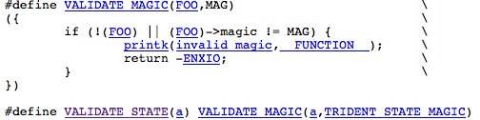
Checking derived lock functions
/* fs/proc/inode.c:41:de_put: */
lock_kernel(); if (!de->count) { printk("de_put: entry already free!\n"); return; } unlock_kernel();
Simplest:
Evilest:
/* 2.4.1: drivers/sound/trident.c:trident_release: lock_kernel(); card = state->card; dmabuf = &state->dmabuf; VALIDATE_STATE(state);

Slide 53
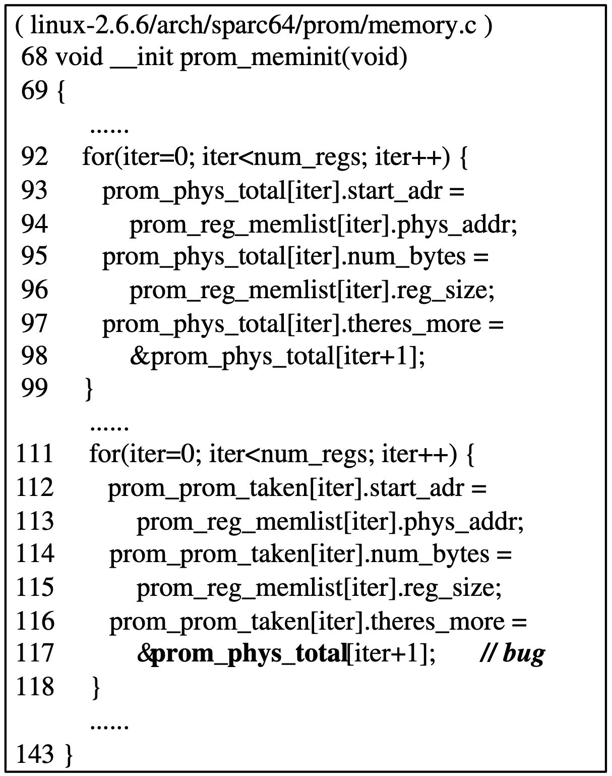
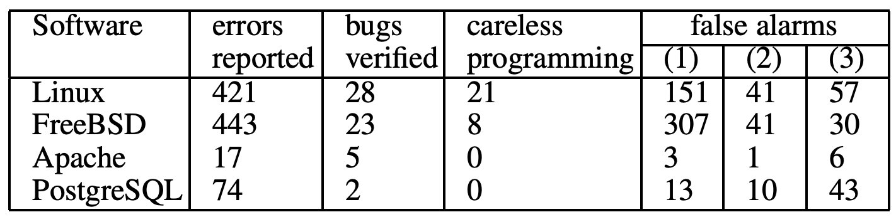
CP-Miner
Many bugs are generated by copy-paste
Find the pattern in the source
[OSDI’04]

Slide 54
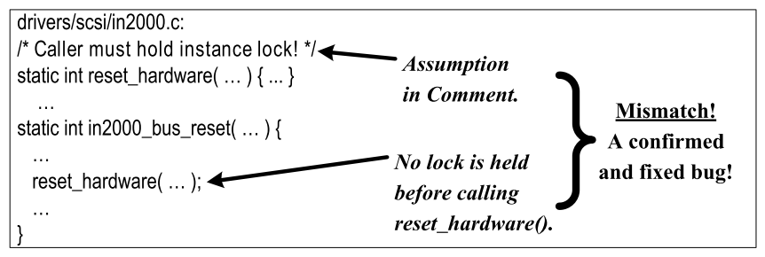
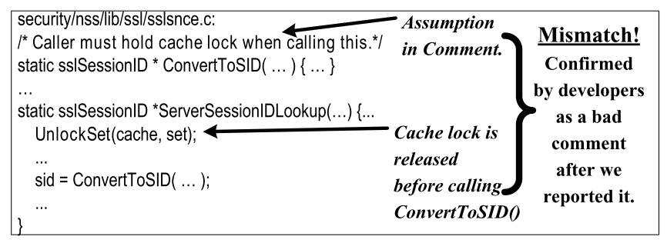
/* iComment : Bugs or Bad Comments ? */ ^{[SOSP’07]}
Inconsistency between bugs and comments

Slide 55
Checking function pointers
struct task_struct
struct file
files_struct *files
file_operations *f_op
struct files_struct
struct file_operations
Kernel text
file **fd
readdir:
push %ebp
…
int (*readdir)(file*,…)
task_struct *current_task
How does kernel get to function pointer?
Start at global root (symbol)
Traverse graph of data structures

Slide 56
Checking function pointers
evil_function:
push %ebp
…
struct task_struct
struct file
files_struct *files
file_operations *f_op
struct files_struct
struct file_operations
Kernel text
file **fd
✔
int (*readdir)(file*,…)
readdir:
push %ebp
…
task_struct *current_task
State-based control flow integrity [Petroni & Hicks]
Start at global root (symbol)
Traverse graph of data structures
Ensure function pointers point to valid entry points

Slide 57
General Rules
Do not call blocking functions with interrupts disabled or spin lock held
Check for NULL results
Do not allocate large stack variables
Do not re-use already-allocated memory
Check user pointers before using them in kernel mode
Release acquired locks

Slide 58
Unstated Rules in JOS
Interrupts are disabled in kernel mode
Only env 1 has access to disk
All registers are saved & restored on context switch
Application code is never executed with CPL 0
Don't allocate an already-allocated physical page
Propagate error messages to user applications (e.g., out of resources)

Slide 59
Unstated Rules in JOS
A spawned program should have open only file descriptors 0, 1, and 2.
User pointers should be run through TRUP before used by the kernel

